Slide 1


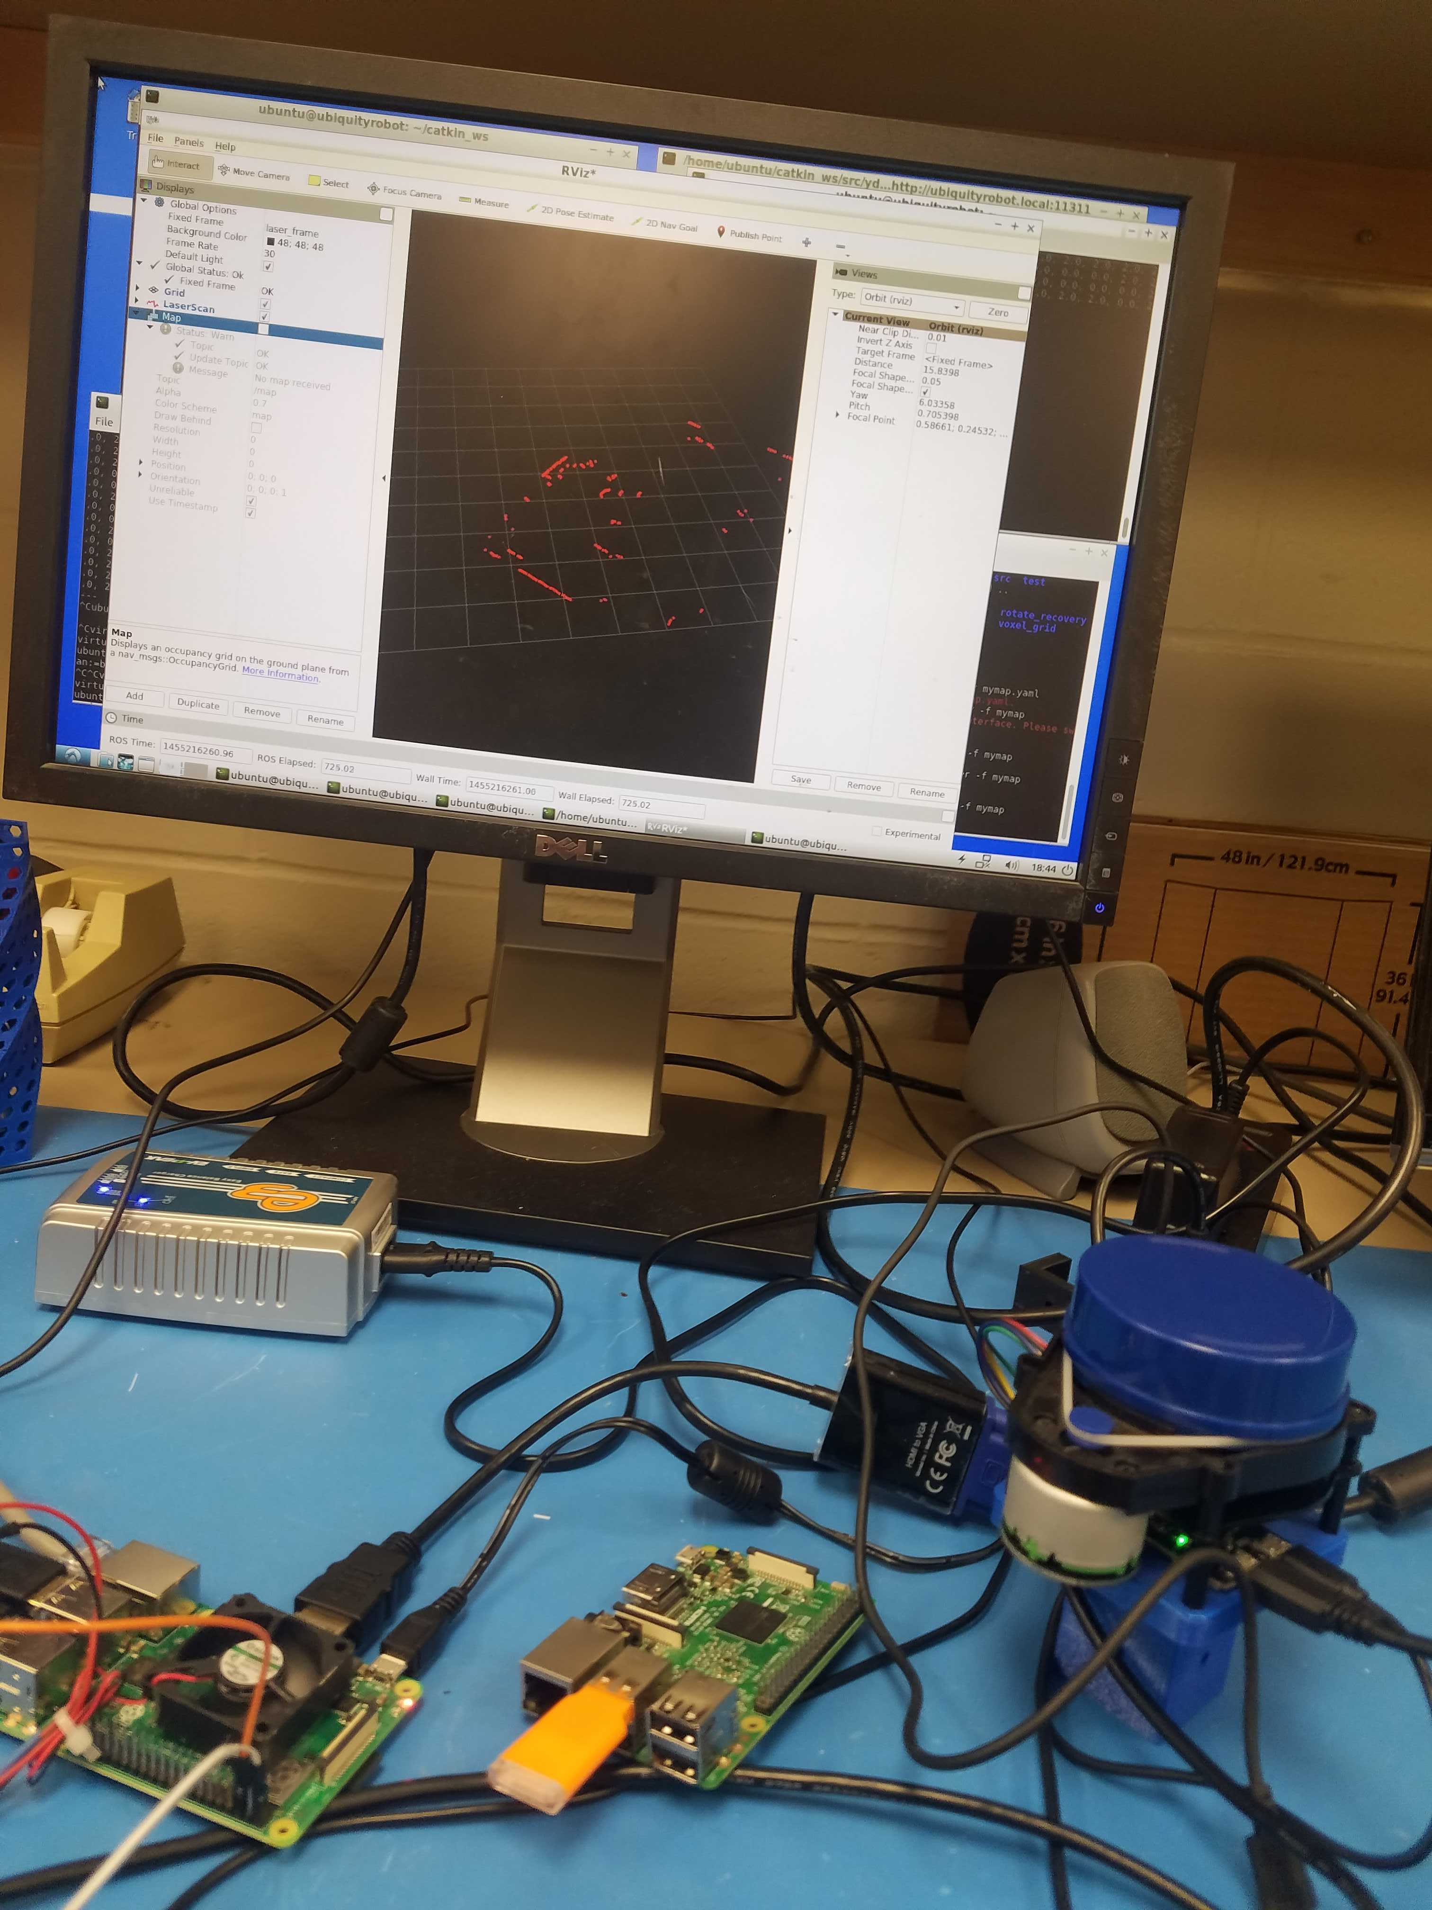
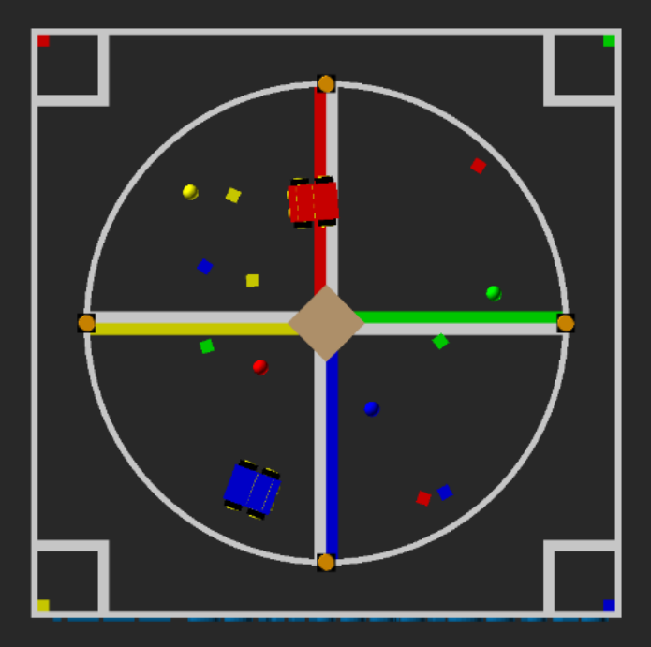
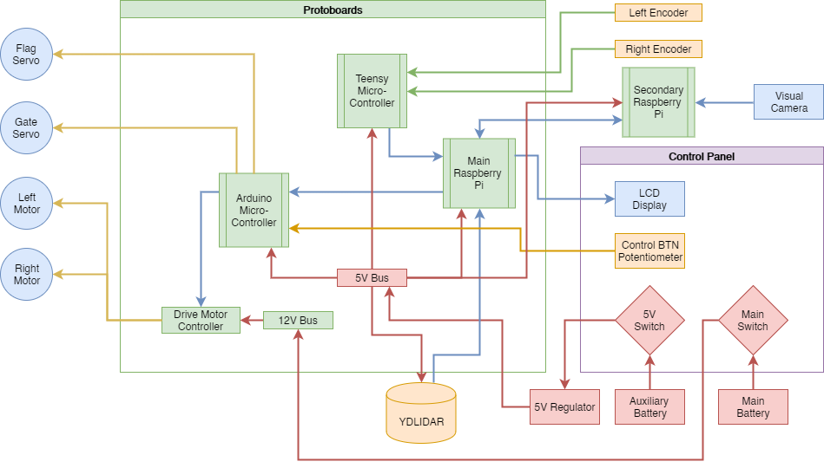
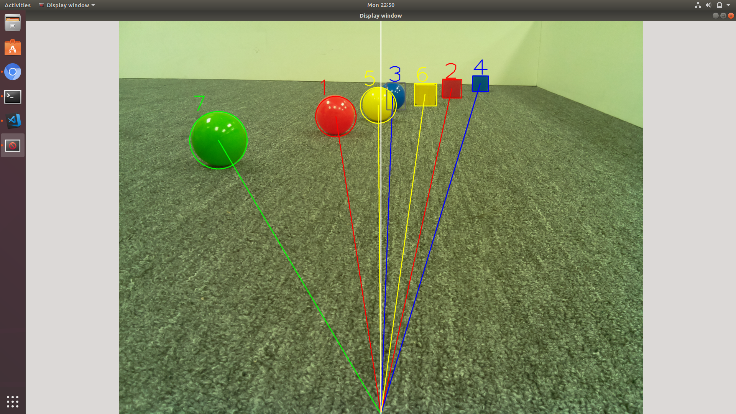
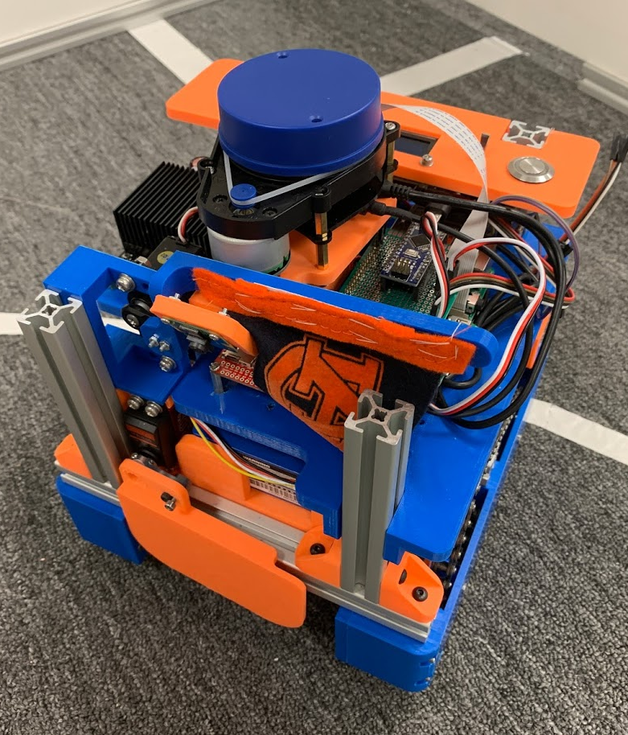
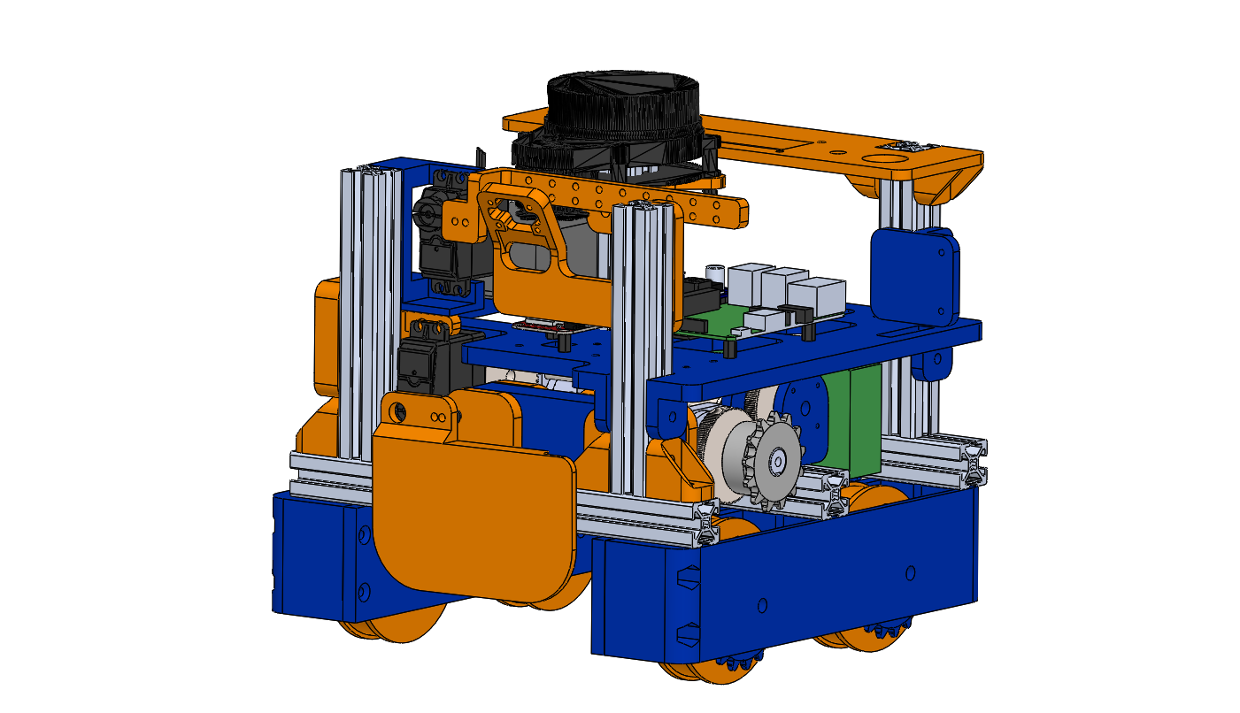
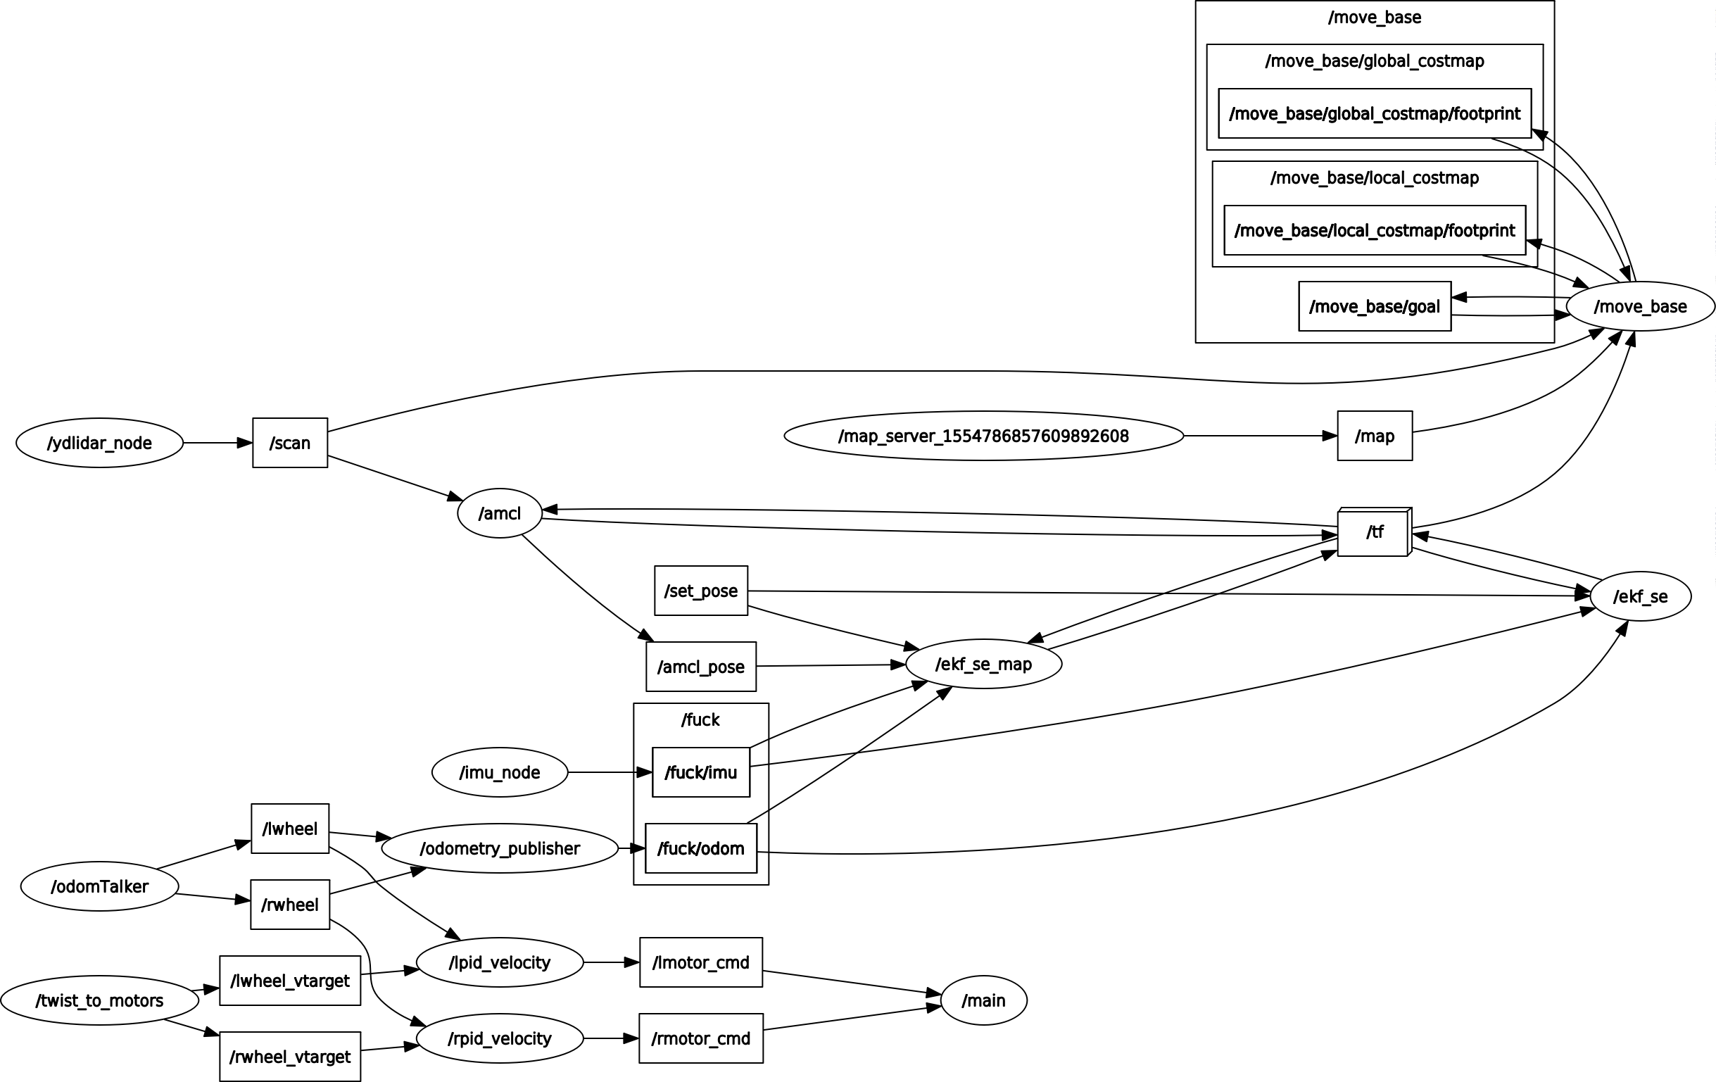
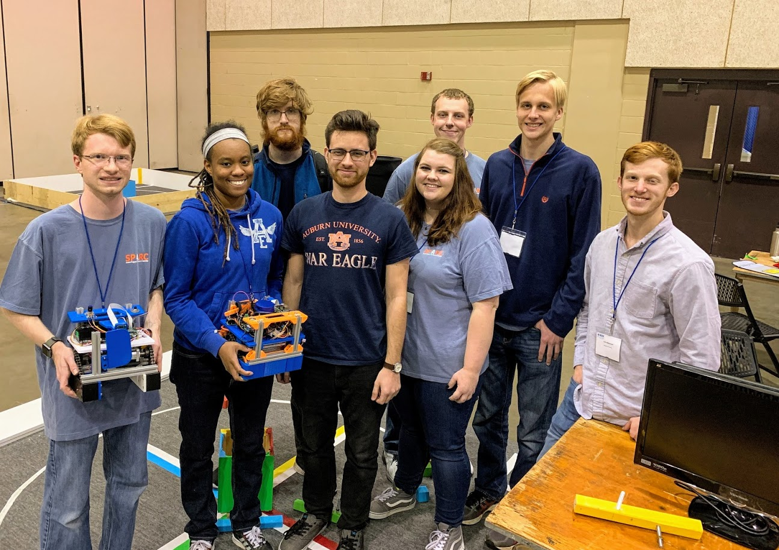
IEEE SoutheastCon 2019 Hardware Competition Team
Senior Design:
Matthew Castleberry, Joe Hinely, Josh Jablonowski, Nia Perkins
SPARC:
William Dovre, Alex Jones, Kevin Ogden, Rebecca Thomas, William Yates
Objective
Electrical Hardware
Localization:
Construct autonomous mobile robot to compete in 3 minute round
Scoring Criteria
5 points for leaving home base
10 points for returning to home base
25 points for raising flag
Up to 15 points per debris move to colored corner
5 points per revolution around center
The robot is controlled using two coprocessing Raspberry Pi 3B+ connected via an ethernet cable. The sensor inputs are rotary encoders, a visual camera, and a 2D LIDAR. A Teensy microcontroller polls the encoders and sends the velocity information to the main Pi. Once the Pi’s determine a desired path, an Arduino microcontroller instructs the motor controllers of the corresponding commands.
The YDLIDAR uses a spinning laser rangefinder to return a 2D point cloud at about 8 Hz. Through ROS, this data is processed along with encoder data to determine an x,y position and orientation of the robot with respect to the field. The Adaptive Monte-Carlo Localization (AMCL) algorithm compares the current point cloud to a prerecorded map.
Object Detection:
A visual camera image is processed using the computer vision library OpenCV. Through our OpenCV algorithms, the robot can determine an x,y position in meters of each debris object with respect to itself. This is possible because the debris has known sizes that can be compared to the recorded pixel sizes.
Mechanical
We constructed a 4 wheel differential drive robot. Each side has a motor powering the wheels with a chain and sprocket system. There is an opening with a movable flap in the center section on the bottom for the debris to be collected. The robot fits within the 9” x 9” x 11” size requirement. It was constructed with an 8020 aluminum frame and custom PLA+ 3D printed brackets.
ROS
Due to the intricate software required to process the selected sensors, we chose the open source framework Robot Operating System (ROS). It consists of a distributed network of nodes. By combining our custom nodes with publicly available nodes, we were able to implement a way to transform the raw collected data to commands to control the robot.

